Slide 1
What is Demand Creation?
Briana Ferrigno, President, McCann Global Health
Notes:
Good morning everyone –My name is Briana Ferrigno, I’m the president of McCann Global Health which is a partner of the OPTIONS Consortium.
I’m going to talk about what we mean when we say “driving demand creation” in the tagline of this preconference: Insight to Impact. And I’ve been asked to do this so that we can utilize a common language for the day – recognizing that there is no one right definition or approach to demand creation as it in has many facets and many different explanations.
And I always like to draw on quotes for inspiration, so let’s kick off with this one from USAID.

Slide 2
conflict of interest
No conflicts of interest to declare.

Slide 3

Consumers everywhere—rich and poor—have hopes and aspirations.
Tapping into those strong emotional sentiments and showing the consumer how the product helps them achieve their desires can be a powerful motivator for product use.
- USAID Report, Idea to Impact
Thank you
Notes:
It reads: Consumers everywhere- rich and poor- have hopes and aspirations.
Tapping into those strong emotional sentiments and showing the consumer how the product helps them achieve their desires can be a powerful motivator for product use.
And at the core-that’s why we are hear. Motivating the use of public health products, the uptake of public health behaviors.

Slide 4
Consumers everywhere—rich and poor—have hopes and aspirations.
Tapping into those strong emotional sentiments and showing the consumer how the product helps them achieve their desires can be a powerful motivator for product use.
- USAID Report, Idea to Impact
Thank you
Notes:
It reads: Consumers everywhere- rich and poor- have hopes and aspirations.
Tapping into those strong emotional sentiments and showing the consumer how the product helps them achieve their desires can be a powerful motivator for product use.
And at the core-that’s why we are hear. Motivating the use of public health products, the uptake of public health behaviors.

Slide 5
WHAT IS
DEMAND CREATION?
First, a CELEBRATION
Notes:
So what is demand creation?

Slide 6
…Advertising
Marketing
Social Marketing
DEMAND GENERATION
PROMOTION
INTERPERSONAL COMMUNICATION
Behavioral economics
Health Communications
First, a CELEBRATION
Notes:
Is it?

Slide 7
Health promotion
SBCC
Communication for development
Market shaping
Strategic communications
Behavior change Communications
Design Thinking
Human Centered Design
First, a CELEBRATION
Notes:
I’m not listing these in jest but actually in celebration
The fact is that the global health community has been innovating on approaches to public health behaviors for quite some time, evidenced by these various approaches. And in truth – we should celebrate our innovation

Slide 8

First, a CELEBRATION
FIRST A CELEBRATION FOR INNOVATION
Notes:
We have looked across displines, with multiple approaches, multiple theories to understand different ways to drive demand. And while this is positive, we also must recognize that as a result of our different approaches, different terms can create tension and even confusion. I won’t parse out which approaches are right or wrong, better or worse, but rather focus on how to have a basic enough framework that anyone of these approaches can work within.
Because really good communicators can take lots of ideas and drill them down into simple concepts

Slide 9
Demand Creation:
Activities to increase awareness and uptake of behaviors, products, and services among specific audiences
First, a CELEBRATION
Notes:
So what is demand creation?

Slide 10
First, a CELEBRATION
Successful demand creation often uses strategic and creative communications that connect EMOTIONALLY with target audiences…
rather than using rational or functional appeals.
Notes:
So I’d like to share with you a quick example of this from the consumer space.

Slide 11

Notes:
There is nothing evolution has ingrained in us more deeply than the desire to protect our children.
This campaign was built off of one powerful message: Protect like a mother. And through a story told with stunningly realistic special effects, Lysol equated their protection through its product to their main consumers’s fierce protection of their children.
Lysol could have provided hard facts showing how their product provides better germ protection than any of the competitors. They could have explained the potential consequences of not using Lysol. But would it have engaged you?

Slide 12
“one of the greatest dangers of advertising is not that of misleading people, but that of boring them to death."
- Leo Burnett
Thank you
Notes:
Like Leo Burnett said, if you want your audience to listen, don’t be boring. Seriously.
We know that in order to influence you need to engage.
- There is nothing evolution has ingrained in us more deeply than the desire to protect our children.
This campaign was built off of one powerful message: Protect like a mother. And through a story told with stunningly realistic special effects, Lysol equated their protection through its product to their main consumers – caregivers- fierce protection of their children.
Alternatively, Lysol could have provided hard facts demonstrating how their product provides better germ protection than any of the competitors and they could have explained the potential consequences of not using Lysol. How do you think that would have worked in comparison?

Slide 13
WHY IS DEMAND CREATION IN
PUBLIC HEALTH IMPORTANT?
Notes:
So why is demand creation in public health so important?

Slide 14
A SUPPLY OF WELL-DESIGNED HEALTH PRODUCTS AND SERVICES IS ONLY ONE HALF OF THE BATTLE.
PROGRAMS WILL SUCCEED OR FAIL BASED ON DEMAND.
Notes:
Creating well-designed health products and services and ensuring their supply and delivery is only half of the battle.
You can design the best product or service, ideally suited to your audiences needs, but if you don’t think through how you’re generating demand, nothing else matters.
In public health, where behavior change is often required, demand creation is the greatest challenge. But we are all demand creators for health

Slide 15

WHO DOES
DEMAND
CREATION FOR
PUBLIC HEALTH?
Program Designers and Implementers
Public Health Marketers
Ministries of Health
Health Care Workers
Advertisers and Marketers
Friends and Family
Notes:
Whether you’re a program designer
An implementer
A public health marketer
A health care worker
And Advertiser or marketer
A friend or family member.. Everyone can play role of driving demand.
And the good news is that we have a lot of experience to go off of

Slide 16
We have a lot of experience
to learn from
Notes:
And the good news is that we have a lot of experience to go off of

Slide 17
Good and bad
We have a lot of experience
to learn from
Notes:
Bothh good and bad experience
From global brands that have the best marketing in the world.

Slide 18
First, a CELEBRATION
More than just technology,
but a symbol of thinking differently
Notes:
Brands like Apple. When you see Apple – they’re more than computers and gadgets. They stand for creativity and thinking difficulty

Slide 19
First, a CELEBRATION
More than just technology,
but a symbol of thinking differently
More than just sneakers, but
a symbol of courage and teamwork
Notes:
Nike- more than just sneakers or high performance wear – but courage and teamwork

Slide 20
First, a CELEBRATION
More than just technology,
but a symbol of thinking differently
More than just sneakers, but
a symbol of courage and teamwork
More than just soda pop, but a symbol of
happiness
Notes:
And there are a million other soda brands out there – but none of them stand for ”opening Happiness” like Coca Cola has for so many years
Beyond just these big-name brands, we have lessons from demand creation throughout history.. From

Slide 21
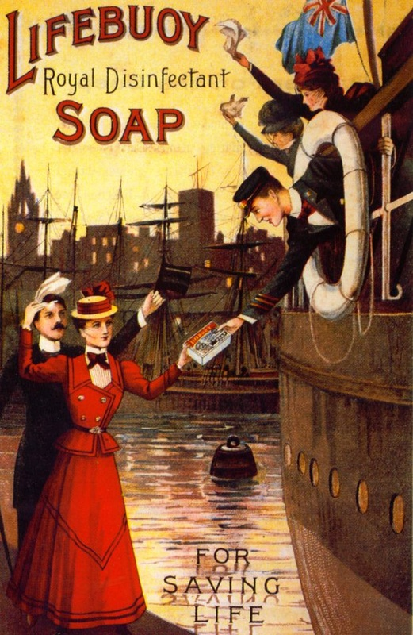
SOURCE
http://www.vintageadds.co.uk
Notes:
How we sell soap
http://www.vintageadds.co.uk

Slide 22
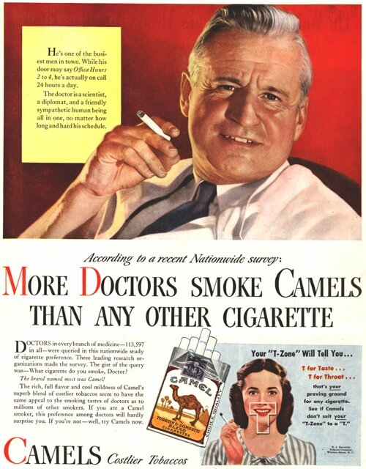
SOURCE
http://www.vintageadds.co.uk
Notes:
To promoting cigarettes with doctor testimonials

Slide 23

SOURCE
FDA
Notes:
to promoting against cigarettes

Slide 24
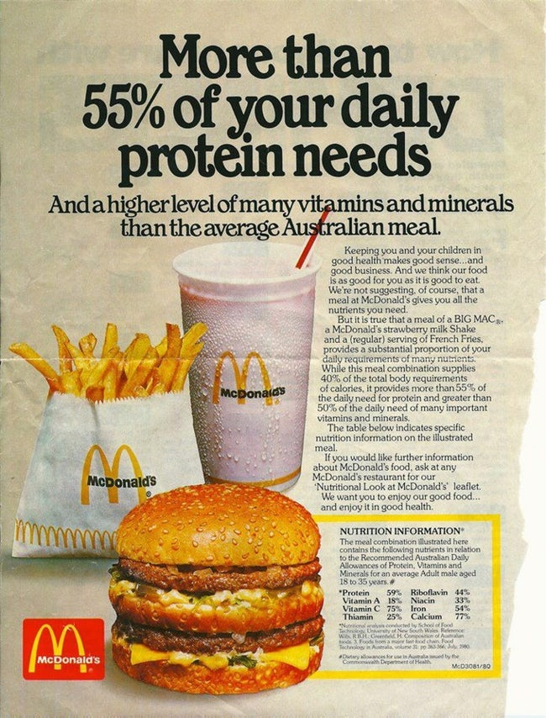
SOURCE
http://www.vintageadds.co.uk
Notes:
To how companies positioning their food as healthy choices

Slide 25
SOURCE:
NYC Dept of Health
Notes:
To how governments and schools promoting their version of health eating

Slide 26
Notes:
The fact is that hundreds of brands and organizations spend millions of dollars on generating demand for their product or service

Slide 27
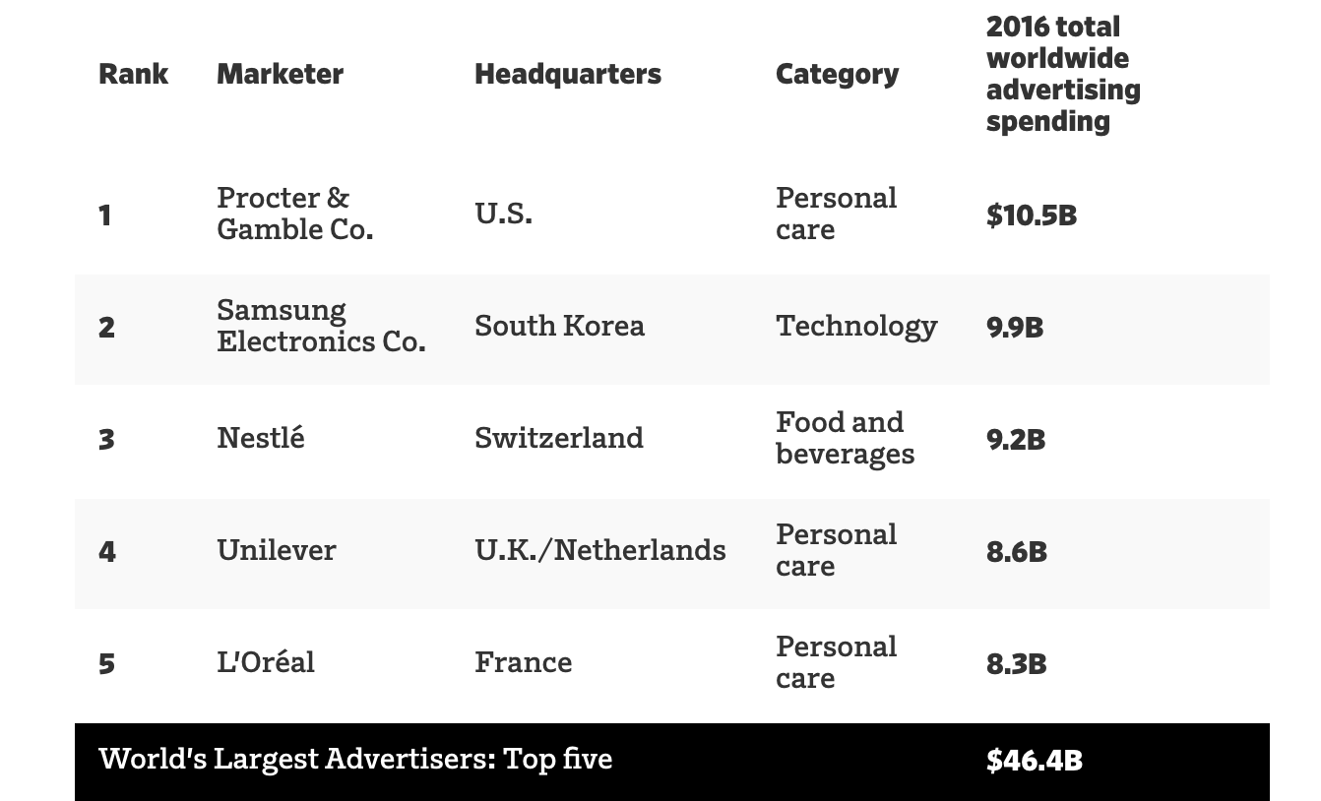
To put it in perspective
SOURCE AdAage, 2017
Notes:
To put it in perspective of just how much some players will value demand creation, Proctor and Gabel spends 10.5 Billion a year on advertising
Unicliver 8.6 billion

Slide 28
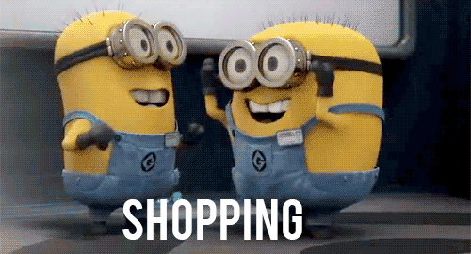
Notes:
And we know in most parts of the world, this is a huge driver consumerism.

Slide 29

DIFFERENT AIMS
DIFFERENT BOTTOMLINES
DIFFERENT VALUES
BUT…
Notes:
Now, as public health communicators, we have different aims, different bottom lines, different values

Slide 30
THERE ARE FUNDAMENTAL, HUMAN TRUTHS THAT HELP DRIVE DEMAND.
Notes:
Now, as public health communicators, we have different aims, different bottom lines, different values

Slide 31
HOW DO WE
RELEVANT?
MAKE IT

Slide 32
HOW DO WE
MEANINGFUL?
MAKE IT

Slide 33
HOW DO WE
EASY?
MAKE IT

Slide 34
START BY
CLEARLY
ARTICULATING OJBECTIVE AND AUDIENCES

Slide 35




Insight
Strategy & Tactics
Media
Impact

Slide 36

Insight
Who is your user?
What is their reality like?
What is important to them? What do they value?
What are their ambitions?
What makes them tick?

Slide 37
"Facts are irrelevant.
What matters is what the consumer believes."
- Seth Godin
Thank you
Notes:
Like what Seth Godin said, facts are irreleveant what matters most is

Slide 38

Strategy & Tactics
What do you need to say?
How are you going to say it?
Who is going to say it?
What emotions will we evoke?

Slide 39
“I’ve learned that people will forget what you said, people will forget what you did, but people will never forget how you made them feel.”
- MAYA ANGELOU
Thank you

Slide 40

Media
Where are you going to say it?
Why are these the right channels?

Slide 41
1 in 3 of 18–24-year olds believe technology will eliminate the need for doctors
63%
OF WORLD POPULATION OWN A CELL PHONE
20% of people trust information about wellness from social networks more than their doctor
Thank you
Source: McCann Truth about wellness
Notes:
In a recent study that McCann conducted called Truth About Wellness, which ran in 18 markets with 18,000 peope.

Slide 42

IMpact
What does success look like?
How will you measure it?
What will you learn and share?
Notes:
And this last point is really what today is about. How do we learn and share experiences about demand creation today. How do we look at what’s worked, what hasn’t, what is really new and interesting, what excites us.. So that we can be better, savier drivers of demand .All the while being mindful that

Slide 43
“Success is not final, failure is not fatal: it is the courage to continue that counts.”
-Winston Churchill
Thank you
Notes:
Success in not final, failure is not fata. It is courage that countries that counts.
So with this context in mind, let’s move forward together faster to drive demand for health. Thank you

Slide 44

Notes:
Where are we have we failed, where have we succeeded

Slide 45




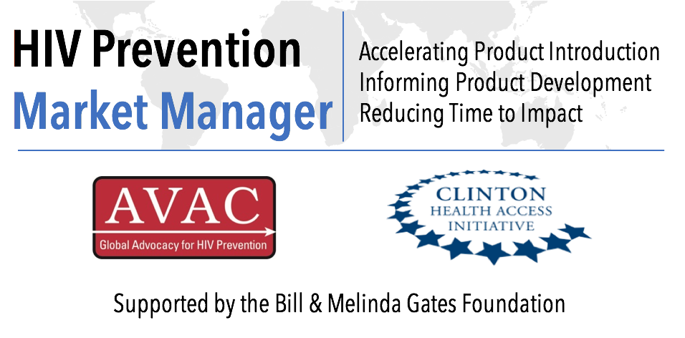



acknowledgments
This program is made possible by the generous assistance from the American people through the U.S. Agency for International Development (USAID) in partnership with PEPFAR.
The contents do not necessarily reflect the views of USAID or the United States Government.

